Slide 1
Search Engine

Slide 2
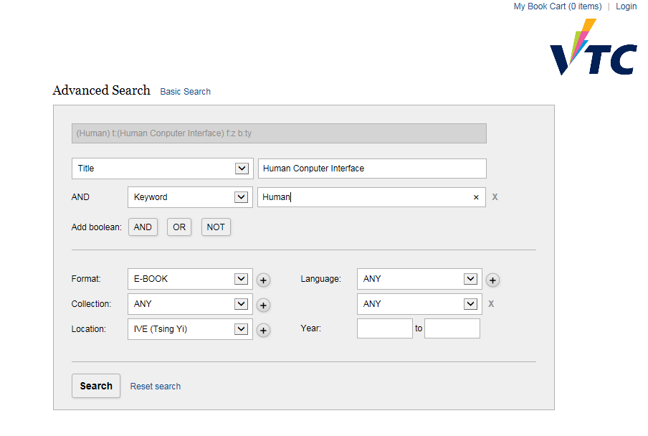
VTC Library

Slide 3
1. Formulation
Use simple and advanced search
Limit the search using structured fields such as year, language, or location
Control the size of the initial result set
Use scoping of source carefully
Provide suggestions, hints, and common sources

Slide 4

2. Initiation of action
Explicit button for action :
Implicit actions are initiated by changes to a parameter and update results immediately
Guide users to successful or past queries with auto-complete

Slide 5
3. Review of results
Keep search terms and constraints visible
Provide an overview of results(e.g. total no.)
Highlight search terms in results
Allow examination of selected items
Allow adjustment of which fields are displayed
Allow change of sequencing (alphabetical, chronological, etc)

Slide 6
4. Refinement
Guide users in progressive refinement with meaningful messages
Make changing of search parameters convenient
Provide related searches
Provide suggestions for error correction (without forcing correction)

Slide 7
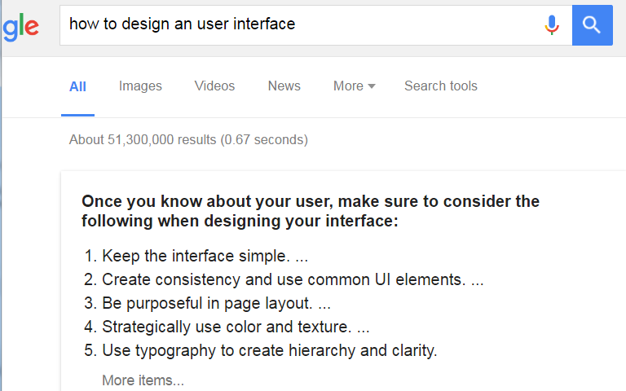
5. Use
Imbed actions in results when possible

Slide 8
5. Use
Results may be merged and saved, disseminated by email, or shared in social media
Explore collecting explicit feedback (ratings, reviews, like, etc.)

